Slide 1

CMSC 137
Data Communications and Networking
Lecture Module
18 – Network Layer

Slide 2
Module 18: Network Layer
Rozano S. Maniaol
Lecturer

Slide 3
Introduction
The network layer is responsible for the delivery of the individual packets from the source to the destination host
Duties:
  Packetizing – encapsulating the payload in a network-layer packet at the source and decapsulating the payload from the network-layer packet at the destination
  Routing – finding the best one among possible routes
  Forwarding – action applied by each router when a packet arrives at one of its interfaces

Slide 4
Logical Addressing
A universal addressing system in which each host can be identified uniquely regardless of the underlying physical network

Slide 5
IPv4 Address

Slide 6
IPv4
RFC 791
32-bit addresses that uniquely and universally defines the connection of a host or a router
Address of the connection, not the host or router, because if the device is moved to another network, the IP address may be changed
has 2³² or 4,294,967,296 address space
partitioned into four groups of eight bits (called octets)
each octet is treated as independent unit

Slide 7
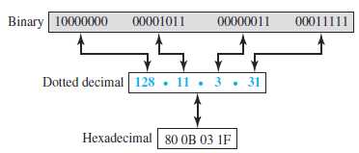
IPv4 Address Notation

Slide 8
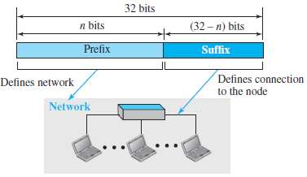
Hierarchy in Addressing
A 32-bit IPv4 address is hierarchical divided into 2 parts:
  Prefix – defines the network
  Suffix – defines the node

Slide 9
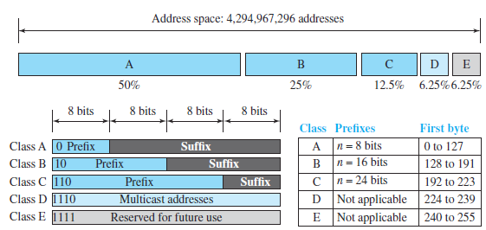
Classful Addressing
Address space is divided into 5 classes: A, B, C, D and E
Classification is determined by the value of the first four bits (bits 0 through 3)

Slide 10
Classful Addressing
IP Class | A | B | C | D | E
Format | N.H.H.H | N.N.H.H | N.N.N.H | N/A | N/A
High order bits | 0 | 10 | 110 | 1110 | 11110
Address Range | 1.x.x.x to 126.x.x.x | 128.x.x.x to 191.x.x.x | 192.x.x.x to 223.x.x.x | 224.x.x.x to 239.x.x.x | 240.x.x.x to 255.x.x.x
No of bits for network/host | 7/24 | 14/16 | 21/8 | Not for commercial use | N/A
Number of network (block) | 128 | 16,384 | 2,097,152 | 1 | 1
Number of host | 2²⁴ – 2 = 16777214 | 2¹⁶ – 2 = 65534 | 2⁸ – 2 = 254 | (268,435,456) | (268,435,456)
Netmask | 255.0.0.0 | 255.255.0.0 | 255.255.255.0
Purpose | Few large organizations | Medium size organizations | Relatively small organizations | Multicast groups | Experimental

Slide 11
Address Depletion
Since addresses were not distributed properly, the Internet was faced with the problem of the addresses being rapidly used up, resulting in no more addresses available for organizations and individuals that needed to be connected to the Internet
  Class A addresses can be only assigned to 128 organizations in the world with 16,777,216 nodes
  Class E addresses were almost never used

Slide 12
Subnetting/Supernetting
Subnetting
  Divide addresses (Class A and B) into several contiguous groups and assign each group to smaller groups (subnet) or share part of address with neighbors
  Did not work since most large organizations were not happy dividing the block
Supernetting
  Combine several class C blocks to create larger range of addresses
  Did not work since it makes the routing of packets more difficult

Slide 13
Classless Addressing
To overcome address depletion and give more organization access to the Internet, the class privilege was removed
Whole address space is divided into variable length blocks
The prefix defines the block (network); the suffix defines the node
The size of network is inversely proportional to the length of the prefix
Restrictions:
  The addresses in a block must be contiguous, one after another
  The number of addresses in a block must be a power of 2
  The first address must be evenly divisible by the number of addresses

Slide 14
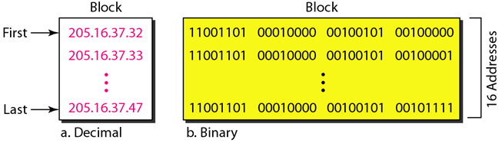
Classless Addressing
Address is contiguous
Number of address is a power of 2 (16 = 2⁴)
First address is divisible by 16
First address when converted to a decimal number is 3,440,387,360

Slide 15

Slash Notation
Question: How to find the prefix length if an address is given?
Since the prefix length is not inherent in the address, it is needed to give the prefix length separately
The prefix length n is added to the address separated by a slash
Formally referred as the classless interdomain routing or CIDR (informally slash notation)

Slide 16
Extracting Information from Address
Given any address in the block, we would like to know the 3 pieces of info: the first address in the block, the last address and number of addresses
  The first address in the block can be found by setting the rightmost 32 – n bits to 0s
  The last address in the block can be found by setting the rightmost 32 – n bits to 1s
  The number of addresses in the block can be found using the formula 2^{32-n}

Slide 17
Extracting Information from Address
Question: A block of addresses is granted to a small organization. We know that one of the addresses is 205.16.37.39/28
  What is the first address in the block?
  What is the last address in the block?
  Find the number of addresses in the block?

Slide 18
Extracting Information from Address
Binary representation of 205.16.37.39
11001101 00010000 00100101 00100111
Set 32 – 28 rightmost bits to 0
11001101 00010000 00100101 00100000
or 205.16.37.32
Set 32 – 28 rightmost bits to 1
11001101 00010000 00100101 00101111
or 205.16.37.47
Value of n is 28, so 2^{32 – 28}
2⁴ = 16

Slide 19
Address Mask
Another way to find the first and last address
32-bit number in which the n leftmost bit are set to 1s and the rest of the bits (32 – n) are set to 0s
A computer can easily find the address mask because it is the complement of (2^{32 – n} – 1)
A computer program can extract information using the 3 bit-wise operations NOT, AND and OR
  Number of address in the block N = NOT (mask) + 1
  1st address = (any address in the block) AND (mask)
  Last address = (any address) OR [NOT(mask)]

Slide 20
Address Mask
Previous sample: 205.16.37.39/28
Binary representation is
11001101 00010000 00100101 00100111
Address Mask: 11111111 11111111 11111111 11110000
Number of address:
NOT(11111111 11111111 11111111 11110000) + 1
00000000 00000000 00000000 00001111 + 1
15 + 1 = 16
First address
11001101 00010000 00100101 00100111
AND 11111111 11111111 11111111 11110000
11001101 00010000 00100101 00100000
205.16.37.32

Slide 21
Address Mask
Previous sample: 205.16.37.39/28
Binary representation is
11001101 00010000 00100101 00100111
Address Mask: 11111111 11111111 11111111 11110000
Last Address
11001101 00010000 00100101 00100111
OR 00000000 00000000 00000000 00001111
00111101 00010000 00100101 00101111
205.16.37.47

Slide 22
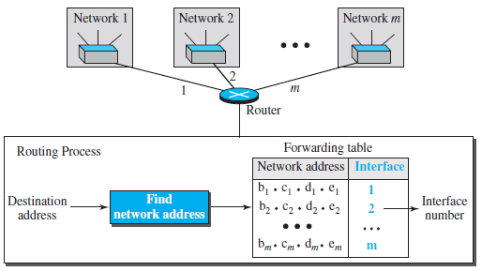
Network Address
When organization is given a block of address, it is free to allocate the addresses to devices that need to be connected to the Internet
The first address (normally) is treated as a special address; it is used in routing a packet to its destination network and defines the organization to the rest of the world

Slide 23
Address Allocation
Internet Corporation for Assigned Names and Numbers (ICANN) – global authority for address allocation
Internet Assigned Numbers Authority (IANA)
  Manages the DNS root, the .int and .arpa domains
  Coordinates the global pool of IP and AS numbers, providing them to Regional Internet Registries
  Manages internet protocol's numbering system

Slide 24
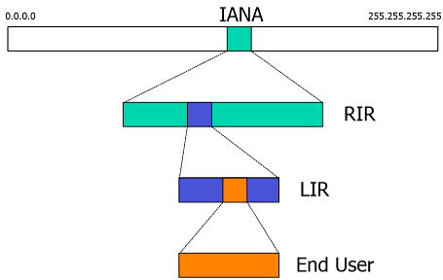
Address Allocation
Regional Internet Registries
- AFRINIC
- ARIN
- APNIC
- LACNIC
- RIPE NCC

Slide 25
Special Addresses
This-host address
  Only address in the block 0.0.0.0/32. It is used whenever a host needs to send an IP datagram but it does not know its own address to use as the source address
Limited-broadcast address
  Only address in the block 255.255.255.255/32. It is used whenever a router needs to send a datagram to all devices in a network
Loopback address
  The block 127.0.0.0/8. A packet with one of the addresses in this block as the destination address will never leave the host

Slide 26
Special Addresses
Private addresses
  4 blocks are assigned as private addresses: 10.0.0.0/8, 172.16.0.0/12, 192.168.0.0/16 and 169.254.0.0/16
  Used in NAT
Multicast address
  The block 224.0.0.0/4

Slide 27
Network Address Translation

Slide 28
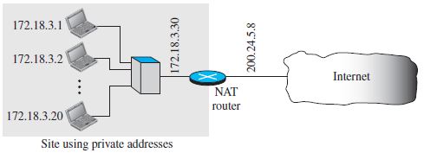
Network Address Translation (NAT)
Technology that can provide the mapping between the private and universal address, and at the same time support virtual private networks
Allows a site to use a set of private addresses for internal communication and a set of global Internet addresses (at least one) for communication with the rest of the world
RFC 3022

Slide 29
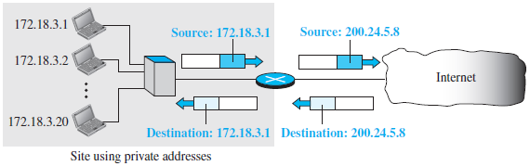
NAT
Address Translation
  All of the outgoing packet go through the NAT router which replaces the source address in the packet with the global NAT address
  All incoming packet also pass through the NAT router which replaces the destination address in the packet with the appropriate private address

Slide 30
NAT
Translation Table
  Using one IP Address
  Using a pool of IP Addresses
  Using both IP Addresses and Port Numbers

Slide 31
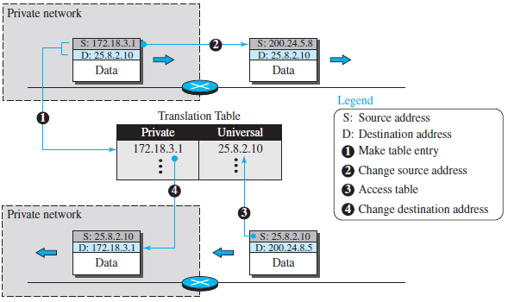
NAT

Slide 32
NAT
Using a pool of IP address
  Use of 1 global address by the NAT router allows only one private-network host to access a given external host
  To remove restriction, NAT router can use a pool of global address
  Example: 200.24.5.8, 200.24.5.9, 200.24.5.10, 200.24.5.11
    4 private-network host can communicate with the same external host at the same time because each pair of addresses defines a separate connection
    However, no private-network host can access 2 external server programs at the same time

Slide 33
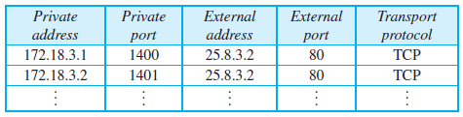
NAT
Using both IP address and Port addresses

Slide 34
IPv6 Address

Slide 35
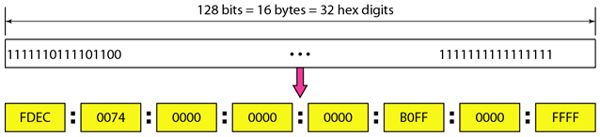
IPv6 Address
RFC 2460
128-bit address (16 bytes/octets)
Uses hexadecimal colon notation

Slide 36
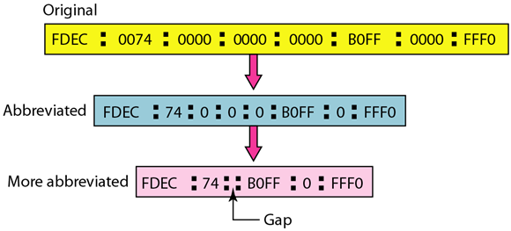
IPv6 Address

Slide 37
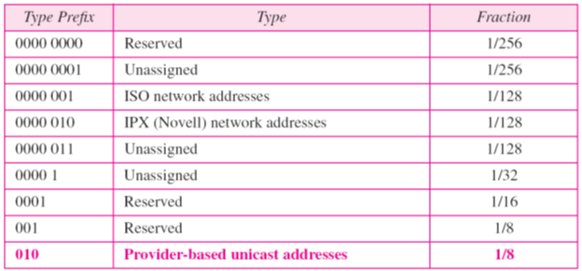
IPv6 Prefix

Slide 38
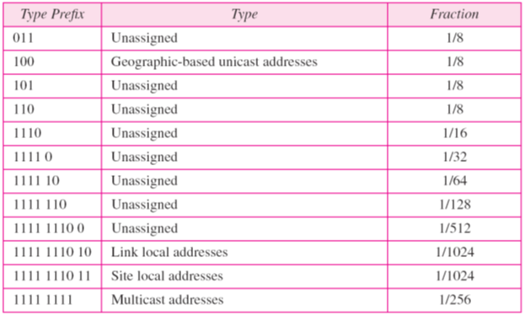
IPv6 Prefix

Slide 39
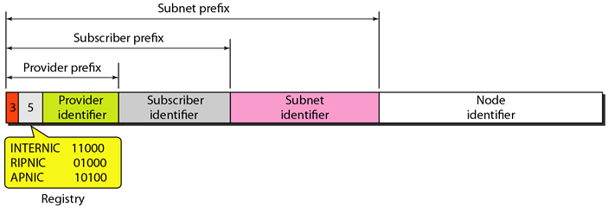
Unicast Address
Defines a single computer
Two types
  Geographically based
  Provider-based

Slide 40
Unicast Address
Type identifier – 3-bit field that defines the address as a provider-based address
Registry identifier – 5-bit field that indicates the agency that registered the address
Provider identifier – variable-length field that identifies the provider for Internet access. (16-bit length recommended)
Subscriber identifier – assigned to an organization when subscribed to the Internet through a provider (24-bit length recommended)
Subnet identifier – defines a specific subnetwork under the territory of the subscriber (32-bit length recommended)
Node identifier – identity of the node connected to a subnet (48-bit length recommended)

Slide 41
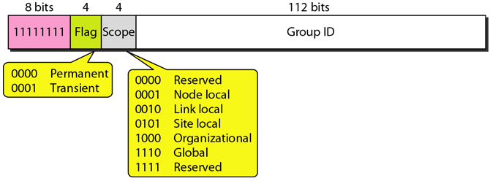
Multicast Address
Defines a group of hosts
A packet sent to a multicast address must be delivered to each member of the group

Slide 42
Anycast Address
Defines a group of nodes like multicast
A packet destined for an anycast address is delivered to only one member of the anycast group, the nearest one.
Possible use is to assign an anycast address to all routers of an ISP that covers a large logical area in the Internet

Slide 43
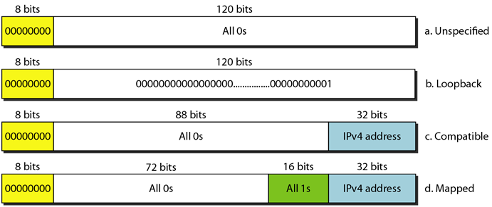
Reserved Address

Slide 44
Reserved Address
Unspecified address – used when a host does not know its own address and sends an inquiry to find its address
Loopback address – used by a host to test itself without going into the network
Compatible address – used when a computer using IPv6 wants to send a message to another computer using IPv6, but the message needs to pass through a part of the network that still operates in IPv4
Mapped address – used when a computer that has migrated to IPv6 wants to send a packet to a computer still using IPv4

Slide 45
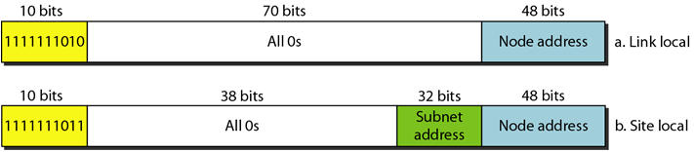
Local Address
Used when organization wants to use IPv6 protocol without being connected to the global Internet
  Link local address – used in an isolated subnet
  Site local address – used in an isolated site with several subnets

Slide 46
References
Forouzan, B.A. 2013. Data Communications and Networking, 5th Ed. McGraw-Hill, New York.

